Slide 1
CA2 – Apply Creative & Computational Thinking to Problems
DAAA/FT/1A/01
Devendran Yoheswaran (2308896)
Nyan Hein (2340911)
Tan Yi Xin (2308937)
Li Yongjie (2342377)
Notes:
Slide 1: Good afternoon, Teacher, and classmates. I am Nyan Hein and here with me are Yongjie, Yohes and Yi Xin.

Slide 2

Problem Identification & Analysis
Notes:
Slide 2: Today we are going to address the problem statement “How can we encourage working adults to adopt low-waste lifestyles?”, targeting SDG (Sustainable Development Goal) 12.

Slide 3
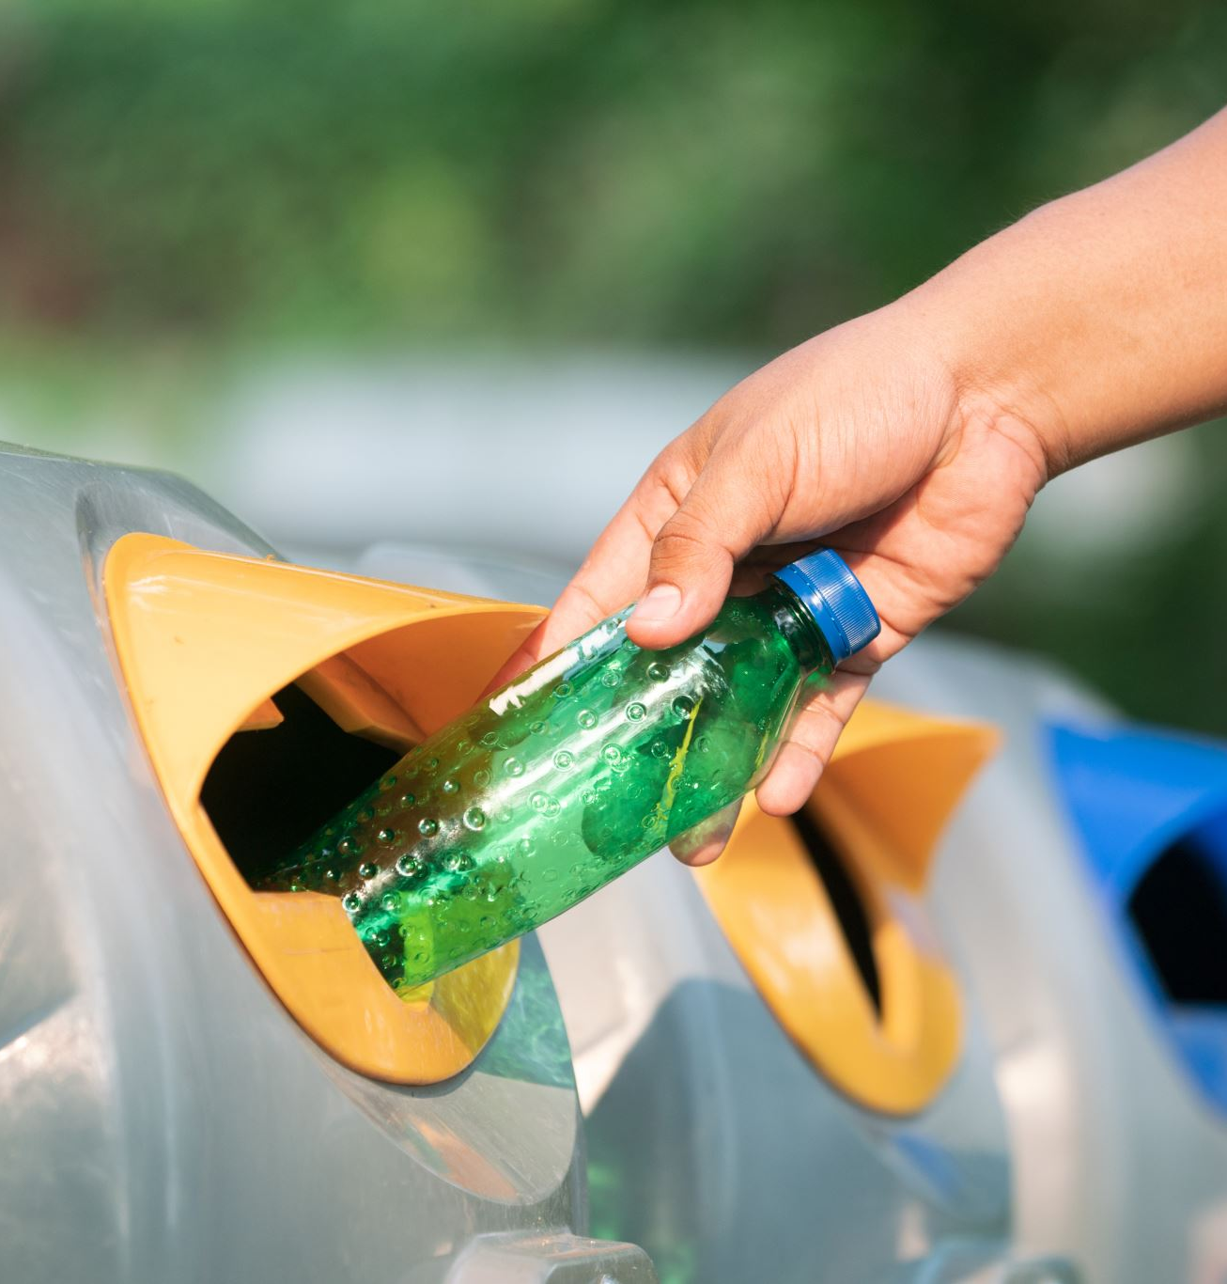
SDG 12 : Responsible Consumption and Production
Problem Statement :
How can we encourage working adults to adopt low-waste lifestyles?
What is low-waste lifestyle?
- A low-waste lifestyle refers to committing to minimizing ones' carbon footprint and waste produced such as being conscious of single-use items and leading a sustainable lifestyle through the 3R’s.
What we hope to achieve : We hope to encourage more working adults to adopt low-waste lifestyles by raising awareness of the benefits of picking up sustainable habits, providing practical tips, and fostering motivation to reduce, reuse and recycle.
Notes:
Slide 3: So, what is a low-waste lifestyle? A low-waste lifestyle means having a life which reduces carbon footprint and production of wastes in our daily lives as much as possible using sustainable practices, such as lowering electricity consumption and using public transportation.
Well, what we hope to achieve from our project or solution is to give a helping hand to working adults so that they will understand the benefits of practicing the sustainable habits and to motivate them to follow such habits.

Slide 4

Scale of the problem IN SINGAPORE
Waste Disposal Problem:
Over the last 40 years, waste disposed in Singapore has increased by 7 times. In 2022, 7.39 million tonnes of waste was generated, while only 4.19 million tonnes being recycled.
79% of domestic waste generated are incinerated, contributing to our carbon footprint.(National Environment Agency Singapore, 2023)
Plastic Waste:
Every year, about 900 million kg of plastic waste is discarded.
In 2022, plastic had the highest percentage of total tonnes of waste disposed(30%) with only a 6% recycling rate. (National Environment Agency Singapore,2023)
Recycling and waste disposal rate in Singapore:
The recycling rate increased from 55% in 2021 to 57% in 2022.
At the same time, waste production rose by 6%. (National Environement Agency, 2023)
Notes:
Slide 4:
The next thing we would like to talk about is about the scale of the problem. Well, environmental problems and sustainability have been a global problem and in Singapore, it also faces its unique own set of challenges. Over the last 40 years, waste disposed has been increased by 7 times. About 70% of domestic waste are incinerated so this contributes to our carbon footprint. In 2022, plastic waste shares the most percentage of wastes we disposed and only 6% was recycled. To elaborate more, while waste production is increased by 6%, recycling rate was increased only by 2% in 2022.

Slide 5

Impact of the problem
If nothing is done to address this issue, Singapore (SG) could face several negative impacts.
Environmental Impact:
Increased waste generation: Singapore's landfills are filling up rapidly, and the country is projected to run out of landfill space by 2035. (National Environment Agency, Singapore, 2023)
Economic Impact:
Increased waste management costs, including collection, transportation, and disposal, will place a burden on public funds and can lead to higher taxes or fees for waste management services.(Channel News Asia, 2022, April 18)
Notes:
Slide 5:
So, what could be the impact of this problems in Singapore? Singapore is a very small country, and it does not have much land. It is expected by 2035, that the space in Semakau landfill for waste disposal will run out. Moreover, the more waste we produce, the more we will have to pay for waste management.

Slide 6

Creative Thinking & Solution
Notes:
Slide 6: Now, we will move on to talk about our solution that we came up with using our creative thinking skills, that we learnt from this module.

Slide 7
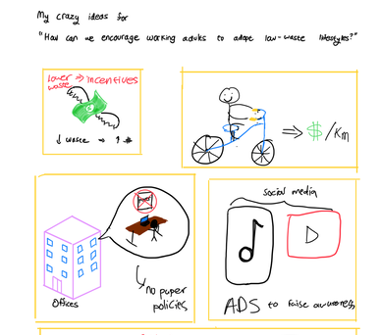
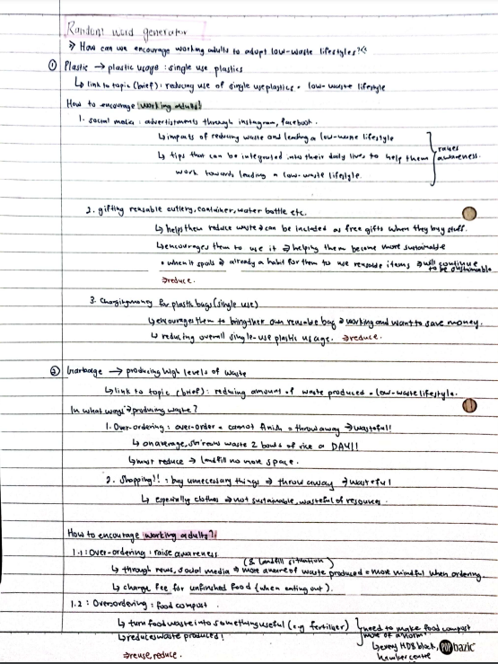
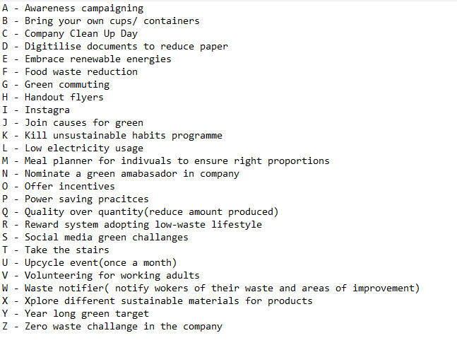
Brainstorming
Brainwriting
Alphabet
Brainstorming
Random Word Generator
Notes:
Slide 7: As shown on the slide, we used these brainstorming methods; brainwriting to sketch whatever comes to mind, alphabet brainstorming to come up with ideas for each letter, and the random word generator to generate new ideas.

Slide 8
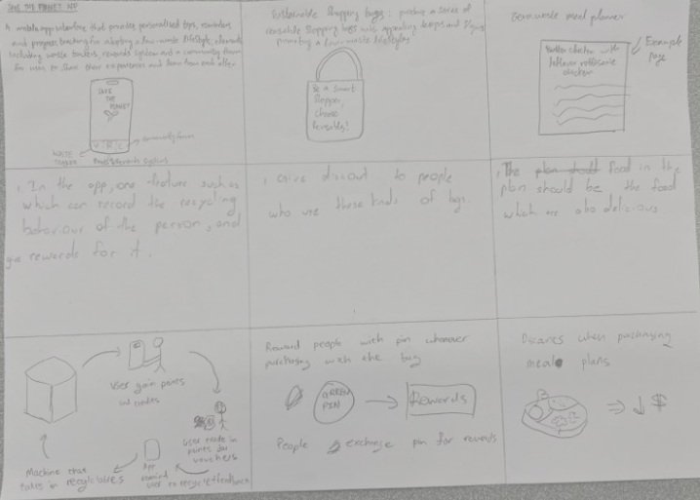
Brainstorming
Shortlisted Ideas
Idea 1: Sustainable Activities App with Rewards
App encourages sustainable actions and reminds users of activities
Earn points for vouchers, catering to busy schedules
Idea 2: 3R's Bag programme
Programme offers reusable bags with store discounts
Promoting eco-friendly choices over single-use plastic bags
Idea 3: Sustainable Living Awareness for Working Adults
Awareness campaign via news letter & social media
Informing consequences of inaction on waste problem
Idea 4: Waste Management Incentives for Companies
Fines and rewards based on waste management & government targets
Encouraging sustainable policies and practices
Grid Brainstorming
Notes:
Slide 8: Through the grid brainstorming, we expanded on each other's ideas in Lesson 3, and have shortlisted these 4 ideas.
Firstly, we came up with a Sustainable Activities App with Rewards, encouraging sustainable actions and different activities, catered to their busy work schedules.
Secondly, we thought of a 3Rs bag programme, offering reusable bags with store discounts, promoting an eco-friendly choice.
We also thought about increasing awareness on sustainable living in working adults, as well as initiating waste management incentives for companies.

Slide 9
SCAMPER
SCAMPER
Substitute | Substitute traditional fabric material used to make reusable bags to more sustainable materials such as recycled plastic or plant-based material such as hemp which is better for the environment.
Combine | Combine the program of eco-friendly bags with a mobile app that can monitor waste and encourage the users' sustainable behavior. Users can accumulate points for using the bags and taking part in environmental activities such as recycling, volunteering or taking public transport.
Adapt | Adapt the designs of the bags to be fashionable reusable-bags rather than ugly boring bag such that workers would not mind bringing it around.
Modify/ Minimize/ Maximize | Maximize the 3R's bag program to expand it to broader range of products instead of limiting it to just a reusable bag. Introduce other reusable products such as reusable coffee cups, food container, etc.. which cater towards the need of working adults.
Eliminate | Eliminate the need to create a new franchise by partnering up with existing retailers that share similar goals. By offering a collaboration and endorsed eco-friendly bags, we can tap into the retailers existing customers and reputation
Reverse/ Rearrange | Reverse the process of providing reusable bags. Instead of providing them with a new reusable bag, get working adults to provide their old cloth to be upcycled and turned into a new bag.
Notes:
Slide 9: After coming up with these ideas, we then used SCAMPER to refine our 3R’s programme idea.
For example, we used C in SCAMPER, combining the program of eco-friendly bags with our Sustainable Activities App. We also used A in SCAMPER to adapt the designs of the bags to be fashionable reusable-bags rather than ugly boring bags so that workers would not mind bringing it around.

Slide 10

Solution from Creative Thinking
Partnership with existing retailers to produce reusable & aesthetically pleasing everyday objects catering to working-adults made from sustainable materials. An app to be developed integrated with product to monitor waste from users, usage of these sustainable products and encourage sustainable behaviour. Point reward system based on use of product and recycling effort. Collaboration with local sustainable businesses to provide incentives or discount to users.
Notes:
Slide 10: After refining our ideas, we came up with our solution from Creative Thinking.
In conclusion, our vision of a partnership with existing retailers to create reusable, fashionable and aesthetically pleasing everyday objects made from sustainable materials to move towards promoting sustainable and low-waste practices among working adults. The development of an app to monitor waste produced, sustainable product usage while also encouraging sustainable behaviours. The introduction of a point reward system, based on reusable product usage and recycling efforts, serves as a powerful motivator to encourage working adults to adopt sustainable practices.
Our solution takes the problem by encouraging working adults to gain points through adopting sustainable practices to receive incentives.

Slide 11
Linkage to Computational Thinking
App that monitor waste and encourage sustainable behaviour
Set up personal waste audits for users
Assess current behaviour
Set personal waste targets to achieve for users
Incentivise for achieving target
If failed to achieve > suggest ways to improve
Notes:
Slide 11: For linkage to computational thinking, we decided to focus and expand on the idea to design the app to monitor waste and encourage sustainable behaviour. This will be done by setting up personal waste audits for the users to quantify their waste. An assessment is done on the current user and their waste produced; targets are then set to achieve for the users. Incentives are provided if they achieve their targets and if they failed, the app suggests ways to improve to hit targets in the future

Slide 12

Computational Thinking
Notes:
Slide 12: We will now look deeper into the process of computational thinking

Slide 13

Decomposition
Our sub-problems identified:
Why aren't adults adopting sustainable habits?
How to inform and educate working adults about the impact of waste on the environment and the benefits of adopting low-waste lifestyles?
What are sources of waste for working adults?
What are ways of encouraging working adults?
Why do working adults produce so much waste?
The sub-problem that our team chose to tackle:
"Why aren't adults adopting sustainable habits?"
Notes:
Slide 13: For the first pillar of computational thinking, decomposition, we broke down our problem statement into four-sub problems to make it more manageable and easier to understand
The out of the three-sub problems the main sub-problem our team chose to tackle is; “Why aren’t adults adopting sustainable habits?”

Slide 14
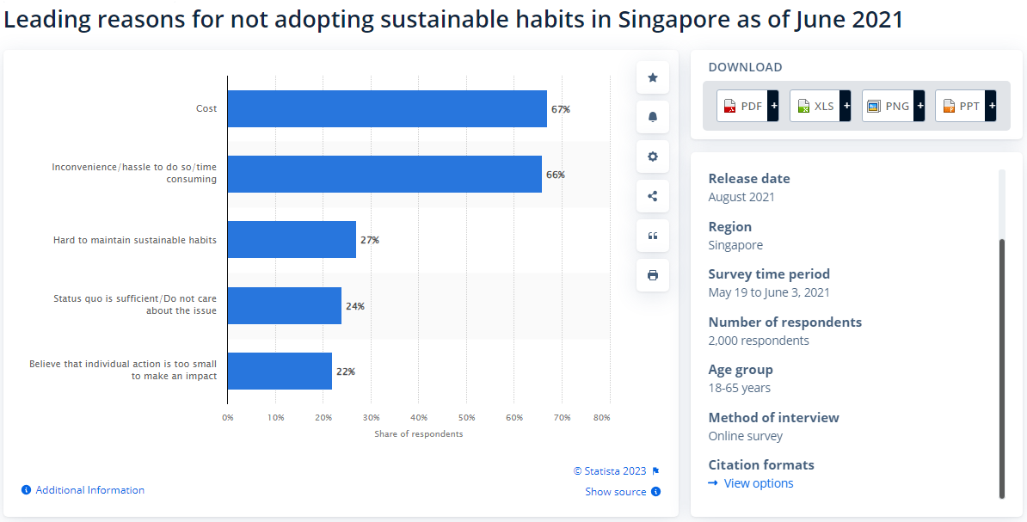
Pattern recognition
Notes:
Slide 14: We then used the second pillar of computational thinking, pattern recognition, to identify patterns in the data on why adults were not adopting sustainable habits.
A survey done on leading reasons for not adopting sustainable habits in Singapore showed that the main two reasons were due to cost and inconvenience, with 67% and 66% of respondents agreeing respectively. The other reasons were due to difficulty maintaining sustainable habits, indifference about the issue and a belief their impact will be too insignificant.

Slide 15

Pattern recognition
Post on Environmental News from Banard College, Colombia: Why Don’t We All Go Green? (Vinokor, R, 2014)
Highlight from the post:
Main reason why people avoid going green is due to belief that it will cost more than their usual unsustainable activities
Lack of education and knowledge on environmental problems
Blog from environmental news website: 5 Main Barriers to Sustainable Living and How to Overcome Them (Ugochukwu, N. , 2019)
5 reasons why people aren't going green are:
It hard to break away from old habits and adopting a new sustainable lifestyle
Cost is one of the biggest challenge and it is hard on people's budget
Convenience of unsustainable practices
Peer pressure at work, weird if only one practicing sustainability
Fear of standing out from the norm
Notes:
Slide 15: Further research was done on a blog and news article to extrapolate more patterns for pattern recognition resulted in us finding out that, both sources agreed that cost is one of the reasons that people avoid sustainable lifestyles. Some other reasons the sources included was due to convenience, peer pressure from colleagues, lack of knowledge on environmental problems.

Slide 16

Abstraction
According to these sources, we found that the most common reasons on why adults don't adopt sustainable practices are due to:
Cost of adopting sustainable practices
Inconvenience that it brings about
Notes:
Slide 16:
According to these sources, through abstraction, we can conclude that are several reasons why working adults don’t adopt sustainability. The most common reasons are cost of adopting sustainable practices and the inconvenience it brings about. Knowing this helps us focus on the key reasons and filter out the unnecessary details.

Slide 17
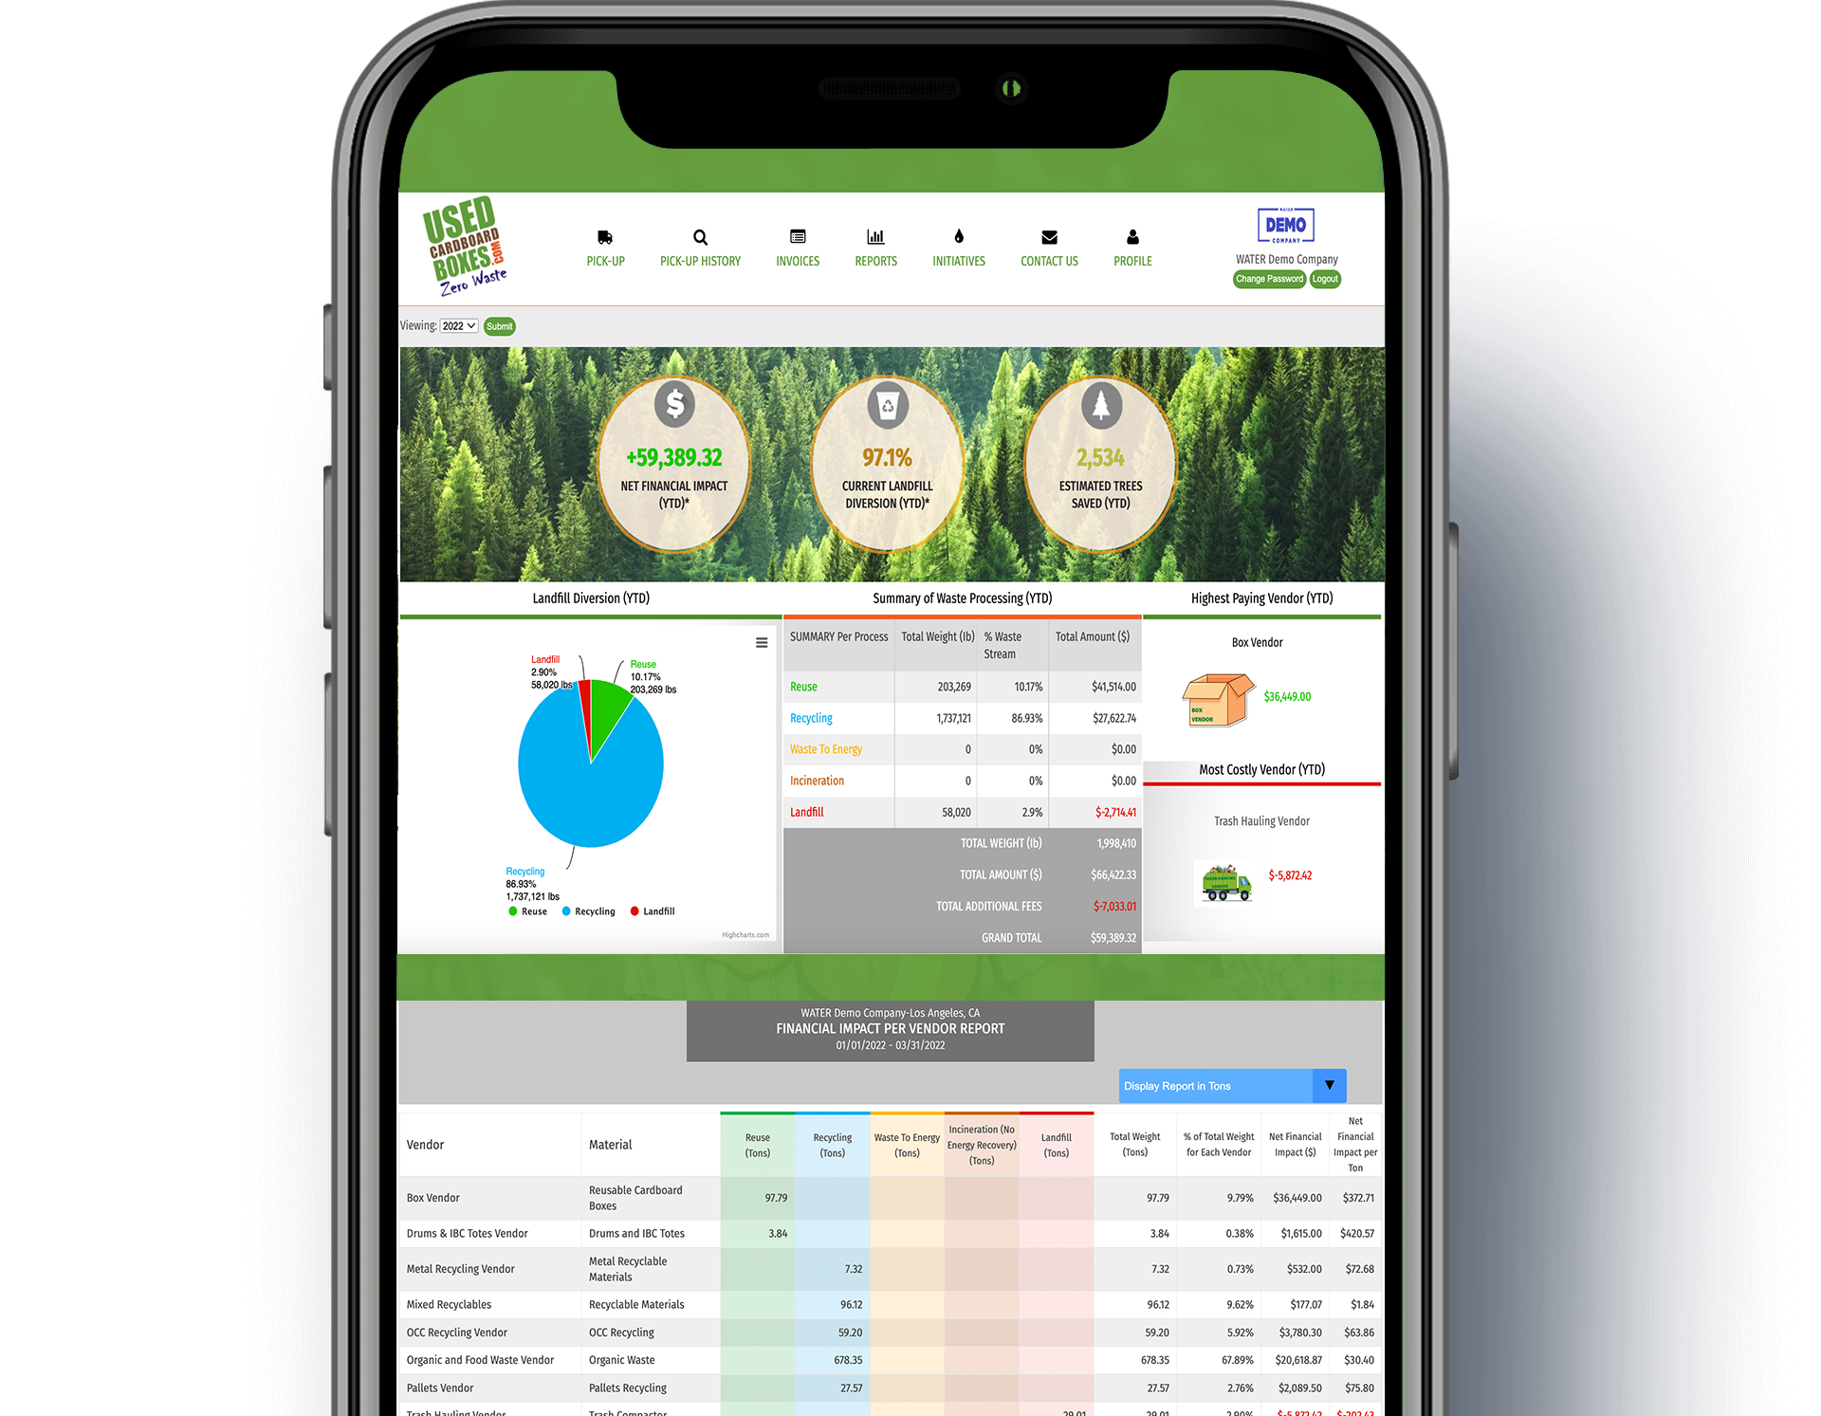
Algorithm design
Solution: Incorporate sustainability at work through incentives and monitoring using an app.
Green monitoring app:
Step 1: Collaborate with Zero Waste City to get companies to set up a waste audit to monitor their waste quantity and quality through the app Step 2: Use various platforms to reach out to companies and persuade them to take part in the initiative Step 3: Replace unsustainable single-use products in company with reusable products and provide proper waste disposal equipment.
Step 4: Based on their waste audit, a personal monthly and annual targets will be set for companies to reduce their waste by 30% by 2030,
Step 5: Reports on monthly targets and provide incentives for employees accordingly
Step 6: Reports on yearly targets and provide incentives for companies accordingly
Notes:
Slide 17:
Using Algorithm Design, we came up with the solution of incorporating sustainability in workplaces through incentives and monitoring using an app.
Firstly, we can collaborate with Zero Waste City to create an app that help companies set up a waste audit to monitor their waste quantity and quality.
Moving on, we can use various platforms to reach out to companies and persuade them to join in and take part in this initiative.
Additionally, we can replace single-use plastic products in company with reusable products and provide proper waste disposal equipment. This would help them get started on reducing waste produced, by making recycling and reusable products more convenient and more accessible for working adults.
Based on their waste audit, a personal monthly and annual target will be set for companies to reduce their waste by 30% by 2030, aligning with Green Plan 2030.
Every month, a report will be given. If targets are achieved stakeholders are provided small incentives and have a new higher target to hit.
If the targets are not hit, involved stakeholders are to be trained through specialist to educate them on sustainability.
At end of the year, companies that hit their target will be green certificates and tax incentives. While those that fail will meet with consultant from Zero Waste City.
As employees are provided with incentives when hitting targets, it solves the issue higher cost of living a sustainable lifestyle. While companies would be motivated to invest in proper waste management and making low-waste more convenient to receive a tax incentive, tackling the problem of inconvenience.

Slide 18
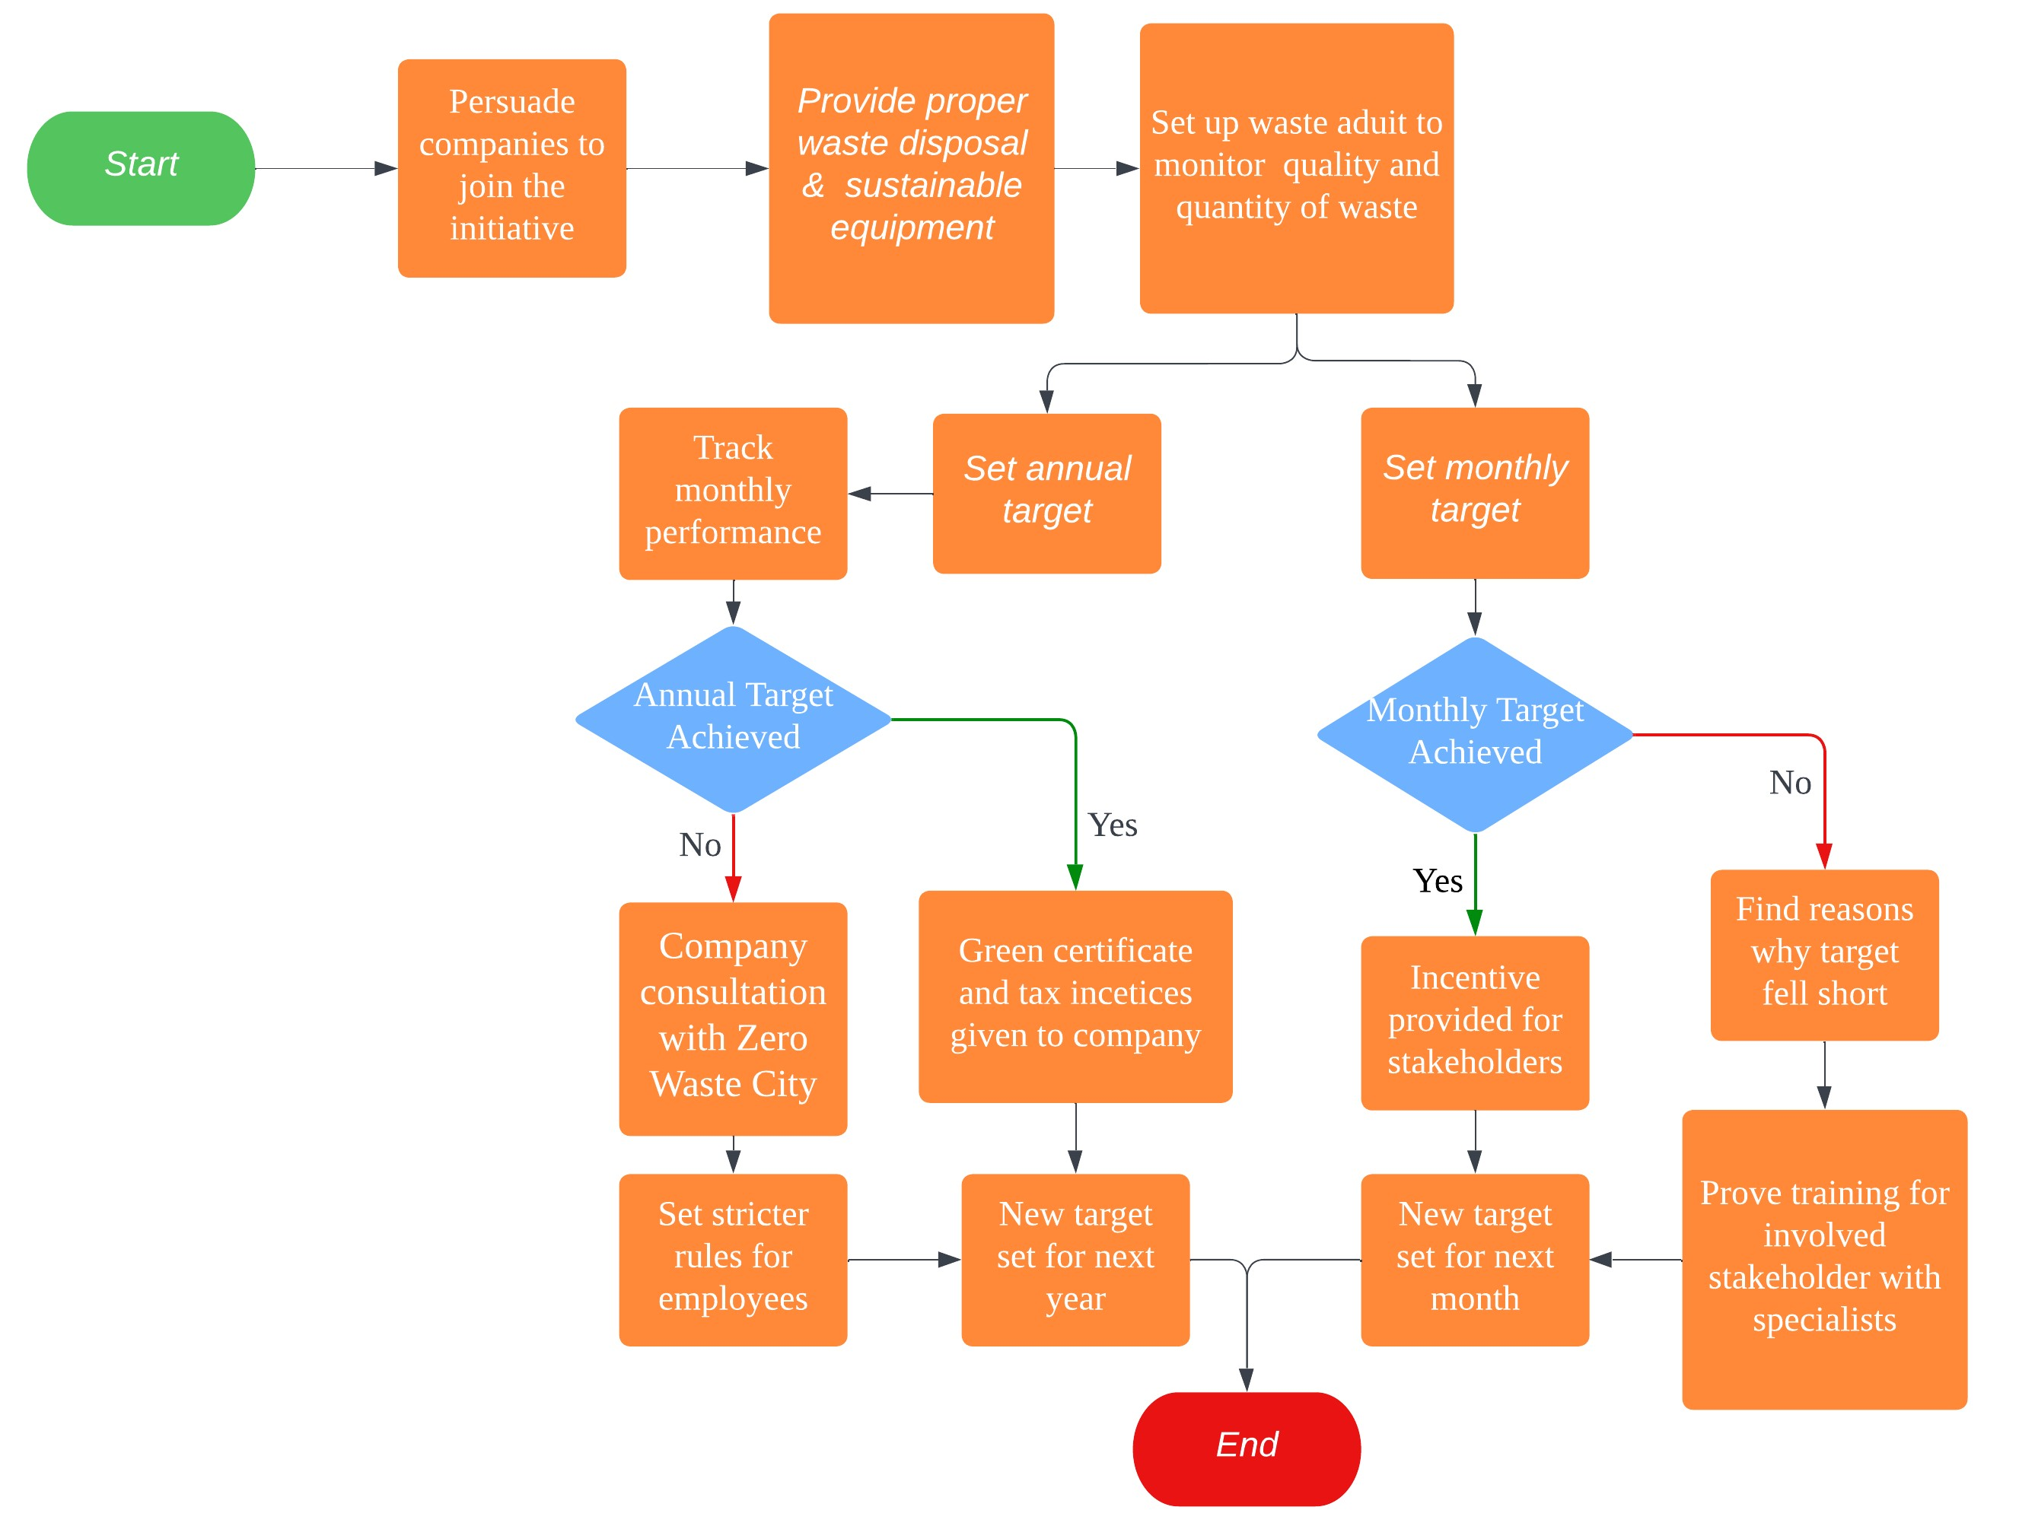
Show the Flowchart
Notes:
Slide 18:
This slide shows the flowchart to our algorithm design.

Slide 19
Final solution
3R's monitoring program:
Key points:
Collaboration with Zero Waste City to develop a dynamic app
Features:
- Track waste using waste audit
- Point reward system
- Newsletter on sustainability and events
Persuade companies to join using various platform by sharing the benefits of the program
Employee's receive benefits such as brand of reusable every-day object that provides incentives when used, and new waste equipment
Target system set in place to encourage waste reduction
Notes:
Slide 19:
For our final solution, we combine our 3R’s program and the Green Monitoring App, a 3R’s monitoring program.
For our programme we will collaborate with Zero Waste City to develop a dynamic app that will contain the following features: Tracking of companies and users waste using a waste audit, a point reward system, and a newsletter on upcoming green events and how be sustainable. In the programme, companies will be persuaded to join the initiative by sharing the benefits.
Employees of participating companies will be provided with a brand of reusable everyday-objects, that provide incentives at eco-friendly cafes and businesses, replacing single-use items in the office. Personal general waste bins in the office will also be replaced with recycling bins to make recycling convenient. Employees can use the point reward to accumulate points through usage of the brand and taking part in events suggested in the app, these points can be turned in for various rewards such as vouchers and time off.
A monthly and annual waste target system will also be implemented that will incentivise companies and employees when achieving their target following the algorithm as stated from computational thinking.

Slide 20

How the final solution addresses the problem
Encourage sustainable habits in the office by providing incentives and rewards from hitting monthly targets and use of the reusable products through the points system.
Easy access to information on how to lead low-waste lifestyles and green events at the tip of their fingers.
At work, recycling is made convenient with recycling bins placed around the office replacing general waste bins.
Participating companies motivated to invest in and promote sustainability in the office.
Working-adults would have these sustainable habits incorporated into their daily lives and become more conscious of single-use items even outside of the office.
Using leading motivators for Singaporeans to encourage adopting low-waste lifestyle
Notes:
Slide 20:
Our programme addresses the problem by encouraging sustainable habits in the office through incentives from hitting waste targets and usage of the reusable products through the points system.
Working-adults would have easy access to information on how to lead low-waste lifestyles and green events at the tip of their fingers through the app, making it convenient for them to learn more during their free time like when their commuting to work. At work, recycling is made convenient with proper waste systems set up.
Participating companies would want to receive tax incentive and obtain green certificate from hitting annual targets and would therefore invest in and promote sustainability in the office.
Working-adults would have these sustainable habits incorporated into their daily lives and become more conscious of single-use items even outside of the office.
A survey from Statistia also showed that the top two factors that would encourage Singaporeans to recycle more was convenience and rewards from recycling with 68% and 65% votes respectively.
In conclusion, we feel that our program will encourage working-adults to adopt low-waste lifestyle by providing incentives and convenience to them in and out of the office.

Slide 21
References (in Harvard citation format) – 1 slide
National Environment Agency(2023) Waste statistics and overall recycling. Available at: https://www.nea.gov.sg/our-services/waste-management/waste-statistics-and-overall-recycling (Accessed: 16 July 2023).
Channel News Asia (2022)18% increase in waste generated in Singapore last year as economic activity picked up . April 18. Available at: https://www.channelnewsasia.com/singapore/waste-generated-2021-recycling-nea-blue-bin-2631336 . (Accessed: 16 July 2023)
National Environment Agency (2023). Waste Generation And Recycling Rates Increased In 2022 As Economic Activity Picked Up. [online] www.nea.gov.sg. Available at: https://www.nea.gov.sg/media/news/news/index/waste-generation-and-recycling-rates-increased-in-2022-as-economic-activity-picked-up (Accessed 25 Jun. 2023)
Statista Research Department. (2023) Singapore: Reasons for not adopting sustainable habits 2021, Statista. Available at: https://www.statista.com/statistics/1312723/singapore-reasons-for-not-adopting-sustainable-habits/ (Accessed: 03 August 2023).
Ugochukwu, N. (2019) 5 main barriers to sustainable living and how to overcome them, Eco Warrior Princess. Available at: https://ecowarriorprincess.net/2019/06/main-barriers-sustainable-living-how-to-overcome/ (Accessed: 03 August 2023).
Vinokor, R. (2014) Environmental leadership, action and ethics, Environmental Leadership Action and Ethics. Available at: https://edblogs.columbia.edu/scppx3335-001-2014-1/2014/04/02/why-dont-we-all-go-green/#:~:text=The%20main%20reason%20many%20people,over%20the%20lifetime%20of%20products. (Accessed: 03 August 2023).
Statista Research Department: Motivation for recycling more often 2023 (2023) Statista. Available at: https://www.statista.com/statistics/1389975/singapore-motivation-for-recycling-more-often/ (Accessed: 04 August 2023).

